Slide 1
Engineering Design DSN2096
By: Akshay Jadhav

Slide 2
Syllabus
Introduction to Engineering design process: Design History; Dieter Rams Principles of Good Design; Overview of Engineering Design Process: Problem Formulation, Concept generation, Project Planning and Design Making; Human Centred Design (HCD);
Design Thinking for Innovation: Design Thinking as Mindset, Process and Toolbox., Enhancing Design Thinking Through, Empathy, Interviewing, Questioning & Brainstorming, Tools for Design Thinking: Mind Mapping, Innovation Flowchart – Question ladder – SCAMPER (for products) Journey Mapping, Task analysis grid (for services)
Engineering Design Approaches: Professional and societal Context of Design; Different types of design – Conceptual, Embodiment designs and Detailed designs – Identification and Specifications, Standards and codes, Design Features – Design for Aesthetics, Production, Standards, Minimum risk, Ease of maintenance, Quality, Minimum cost and Optimum Design, Service Design - People - Asserts - policies - culture. Iterative process - Exploration - Creation - Reflection - Implementation.

Slide 3
Syllabus
Usability & Reliability: Usability – User requirement; User experience; Usability testing; Customer Co-creation; Reliability & Safety: Human and equipment, safety, Risk analysis, and security, System reliability; Use of e-engineering: Modelling, Simulation and Verification.
Prototyping and Visualization: Design Cycle Model, Metaphor method: Theory and methodology of concept generation, Blend method & Thematic Method. Conceptual Design & Design capability and sociality. Prototyping & Visualization Design Tools – E-tools
Sustainable Design: Concepts of sustainable development, Sustainable design principles - Design for Environment; Life Cycle Assessment; Models of sustainable design- Biomimicry, Eco Design, Recycling; Social Innovation
Communication: Articulating design ideas: Storytelling; Sketching & Dynamic Diagrams; K Scripts

Slide 4
Books and resources
TEXT BOOKS:
Huge Jack, “Engineering Design, Planning, and Management” Academic Press, 2013.
Gerhard Pahl, Wolfgang Beitz “Engineering Design: A Systematic Approach” 2014.

Slide 5
Design Categories
# Revolutionary: The design is completely open ended. Concepts are system wide;
Original design, sometimes called innovative design. This form generates a novel and original concept with the goal of achieving a specific need. An original design requires a unique solution based on an invention, and it often involves introduction of new technologies that potentially have long-term consequences.
# Evolutionary: An existing design is to be refined. Some new concepts are required;
Adaptive design, which is a form of design where an existing engineering solution is adapted to satisfy a different need or is used for a novel application. For example, adapting the wired phone receiver and making it wireless for its use in a wireless telephone set. Further adaptive design converts the wireless phone receiver (and the phone itself) into a fully mobile version, the cell phone. Adaptive design is quite common in the engineering design.
Redesign, an engineering design that targets improvement of an existing design. Redesign can be used for expanding of product’s servicing capabilities and functionality, or for reduction of its manufacturing cost. Redesign can be also accomplished for changing product’s properties, while keeping its functionality and cost (sometime even increasing the latter), for example, reshaping a product for the purpose of reduction of its stress concentration.

Slide 6
Design Categories
# Standard: Using well-understood approaches to design. The focus is on the details;
Selection design. Most designs use off-the-shelf components such as gears, bearings, joints, motors, or actuators, etc., that are supplied by their manufacturers or distributors. In this design the task consists of selecting components with the needed properties, quality, performances and cost from the vendors’ catalogs. Selection design is an essential part of most of the design projects.
Product Design and Industrial Design. These two types of design are often confused with each other. This happens because different people, especially in different professions, interpret them in different ways. In general, product design is a design of a product with primary goal to sell it to consumers. Industrial design is also about designing a product for end-users; however, the attention is given first to its functional value, e.g., cars, houses, home appliances, specialized equipment, etc.

Slide 7
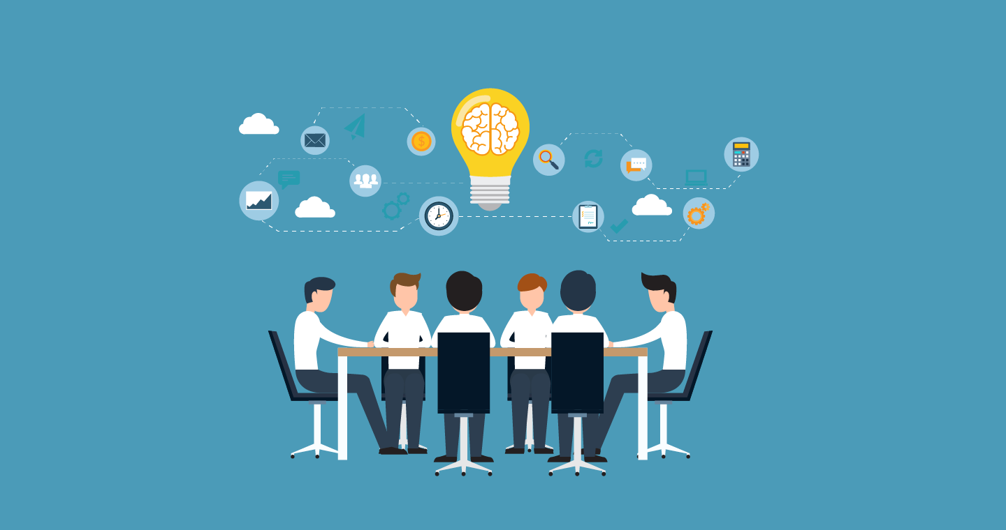
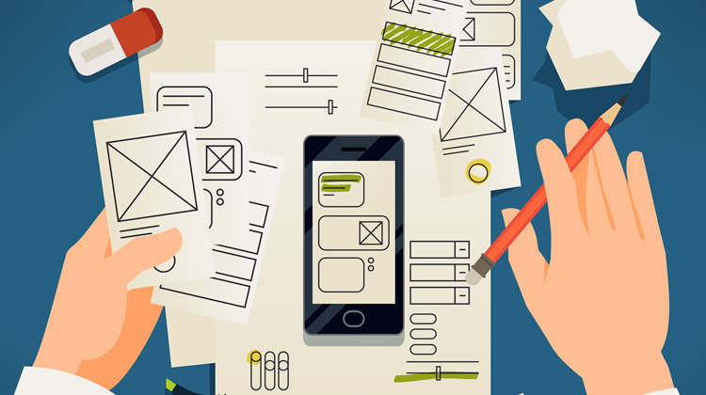

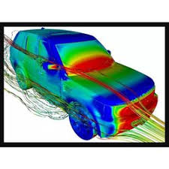
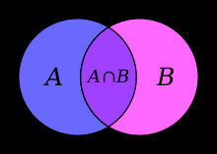


Major concept generation techniques
.
:
Brainstorming
Prototyping
Pilot testing
Axiomatic
Ideation
Survey
Simulation

Slide 8
Brainstorming is a popular technique for concept generation.
It can help you generate many ideas through a group exercise.
A group of 5 to 10 members with a designated leader, including people from different backgrounds, to get diverse ideas.
Describe the problem and the solution criteria to the group, and encourage suggestions.
Being specific in describing what you need helps to focus on the problem and reduce the number of vague ideas.
Set a time limit of 15 to 60 minutes for each session.
Focus on producing ideas without judging them, since the product development team can assess the ideas later.
.
:
Brainstorming

Slide 9
In an engineering product design context, a prototype is a preliminary version of the end-product used to evaluate the design, test the technology, analyse the working principle, and provide final product specifications.
Prototypes are an integral part of engineering product design and, more importantly, in new product development.
Rapid prototyping (RP) quickly creates a physical part directly from its CAD model data using various manufacturing techniques.
Rapid prototyping can be used at any stage of the product development cycle for any components or sub-components.
.
:
Prototyping

Slide 10
Pilot testing is a rehearsal of your research study, allowing you to test your research approach with a small number of test participants before you conduct your main study.
Although this is an additional step, it may be the time best spent on any research project.
Just like proper experimental design is a necessity, it is important to take the time to critique, test, and iteratively improve your research design, before the research execution phase.
By doing so, you can ensure that your user research runs smoothly, and dramatically improve the output from your study.
.
:
Pilot Testing

Slide 11
A simulation imitates the operation of real world processes or systems with the use of models. The model represents the key behaviours and characteristics of the selected process or system while the simulation represents how the model evolves under different conditions over time.
Simulations are usually computer-based, using a software-generated model to provide support for the decisions of managers and engineers as well as for training purposes. Simulation techniques aid understanding and experimentation, as the models are both visual and interactive.
.
:
Simulation

Slide 12
Axiomatic Design is a design technique with a high added value because it reduces the number of possible initial designs to one while consuming almost no resources.
Thus, Axiomatic Design provides a conceptual design that satisfies the motivation.
The configuration chosen is as close to the ideal design as the system permits.
In dealing with the complexity, ADT can be used as a systematic approach to guide the decomposition.
ADT lays the foundation for system analysis and design.
.
:
Axiomatic

Slide 13
Ideation is the a phase of the Design Thinking process, and it’s all about generating ideas.
The Nielsen Norman Group defines ideation as “the process of generating a broad set of ideas on a given topic, with no attempt to judge or evaluate them.”
In the ideation phase, you’ll explore and come up with as many ideas as possible. Some of these ideas will go on to be potential solutions to your design challenge; some will end up on the reject pile.
At this stage, the focus is on quantity of ideas rather than quality.
The main aim of an ideation session is to uncover and explore new angles and avenues—to think outside the box.
For the sake of innovation and creativity, it is essential that the ideation phase be a “judgement-free zone”.
.
:
Ideation

Slide 14
A survey method is a process, tool, or technique that you can use to gather information in research by asking questions to a predefined group of people.
Typically, it facilitates the exchange of information between the research participants and the person or organization carrying out the research.
Survey methods can be qualitative or quantitative depending on the type of research and the type of data you want to gather in the end.
A survey is a data collection tool that lists a set of structured questions to which respondents provide answers based on their knowledge and experiences.
It is a standard data gathering process that allows you to access information from a predefined group of respondents during research.
Interviewing, Surveys, Observation, Focus Group
.
:
Survey

Slide 15
.
:
Some more concept generation techniques;
Reverse brainstorming
Whiteboarding
Mind mapping
6-3-5 Brainwriting
Empathy
Assignment 2: Discuss those techniques?

Slide 16
Product Design

Slide 17
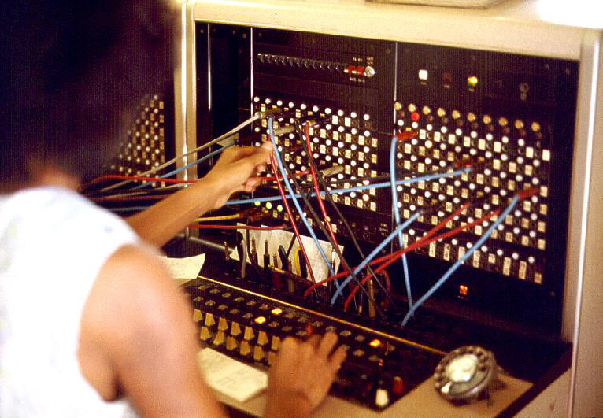

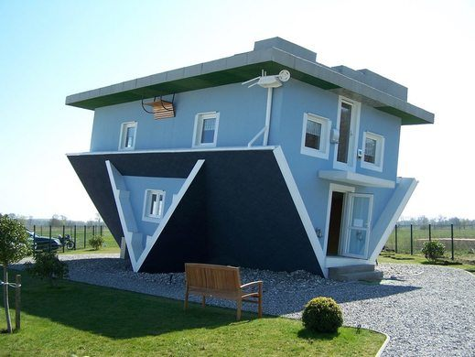
Technology Centred Design
Business Centred Design
Designer Centred Design

Slide 18
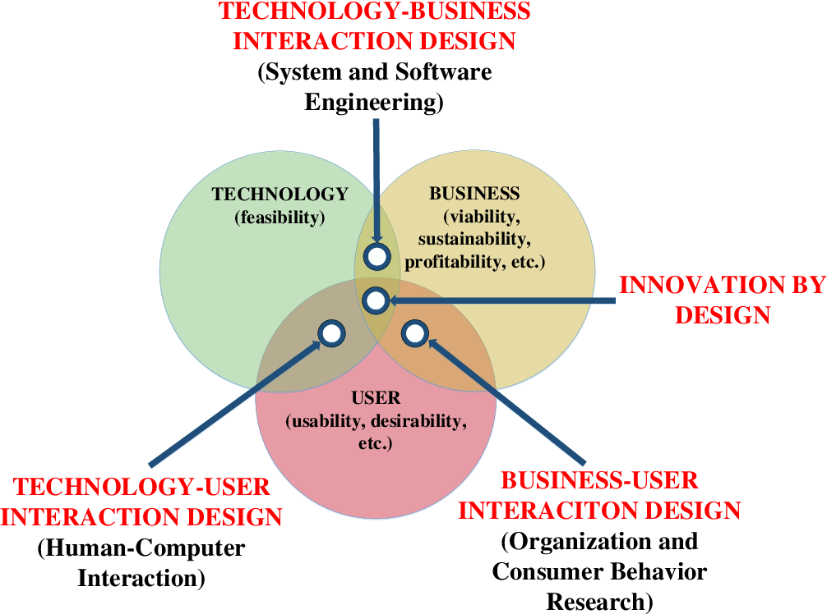

Slide 19
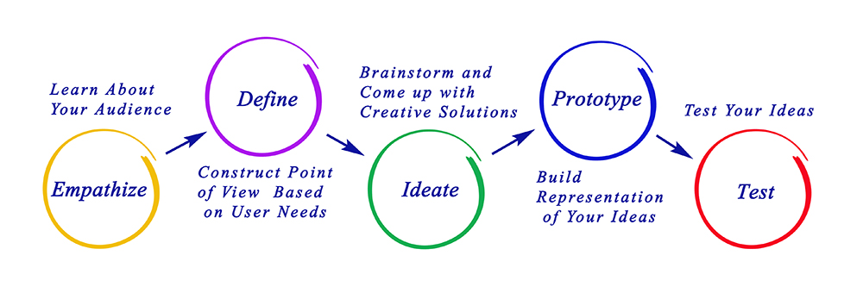
Design Thinking Process

Slide 20
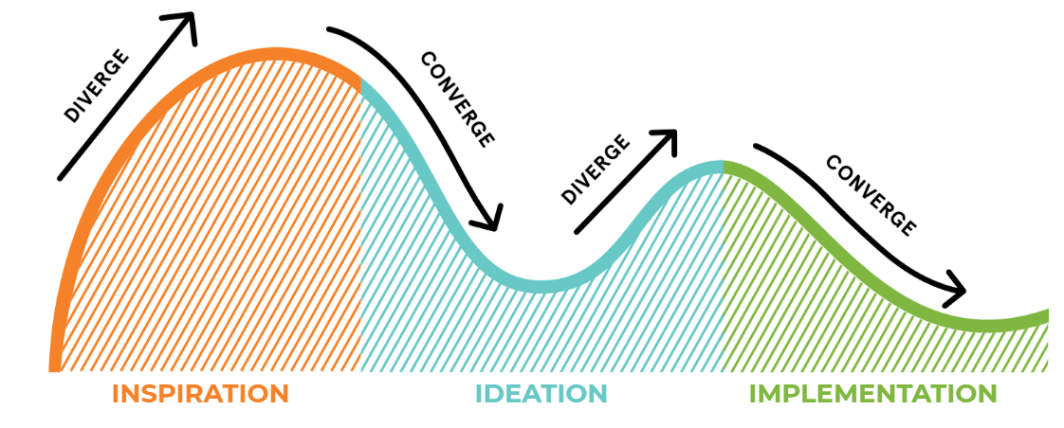
“Design Thinking” and “Human-Centred Design”
Design Thinking, popularized by Stanford’s d.school, is a process that you go through to create solutions that will actually be adopted by people
Human-Centered Design, popularized by IDEO.org, is a mindset that overlays design thinking to ensure that the products are actually relevant and beneficial— in the long run — for the people they are intended to serve.

Slide 21
“Design Thinking” and “Human-Centred Design”
To make this more clear, any business can use Design Thinking to build a solution that is capable of making money. For example, a company may use Design Thinking to create a video game or TV show for kids. Applying Human-Centered Design on top of this will ensure that the show actually serves the needs of the people watching it (for example meeting the learning objectives of the children watching the show or playing the game)

Slide 22
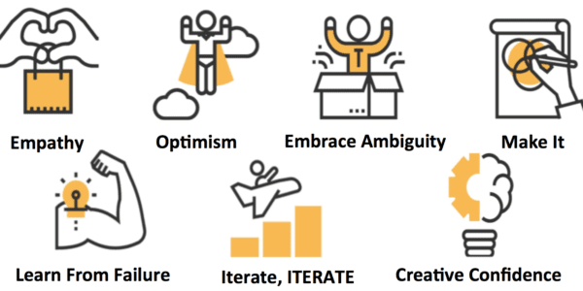
Design Thinking Mindset
By IDEO’s HCDM

Slide 23
Learn From Failure
This mindset is all about the ability to learn from failure and use failure as a tool to improve your practices. As Tim Brown, CEO of IDEO explains, “Don’t think of it as failure, think of it as designing experiments through which you’re going to learn.” Design begins with not knowing the solution to a challenge. Instead of being scared of failure, use every opportunity to experiment and grow from your mistakes.
Make It
Design thinking is about experimenting with prototypes. Make an idea real in order to better understand it and think through the problem. Only through building and testing will you be able to know if a product or service is doing what it should do. Whether it’s a simple cardboard and scissors model, or a sophisticated digital mockup, creating a prototype will allow you to share your idea and gain feedback early and often.

Slide 24
Creative Confidence
This mindset is about approaching the world like a designer. It’s understanding that you have creative ideas and the power to turn those ideas into a reality. Creative confidence allows designers to make leaps and trust their instincts about real solutions to business problems.
Empathy
Empathy is not only a wonderful skill for understanding your customers better, it can also help you solve problems from their perspective and gain insight into the design process. Ultimately, your product or service should be built to help improve other people’s lives and experiences, so never losing sight of an empathetic view of the world is key.

Slide 25
Optimism
IDEO describes design thinking as inherently optimistic. In order to take on a design challenge, you need to believe that progress is an option. Optimism is this embracement of possibility and knowledge that there is a better solution to the problem out there.
Embrace Ambiguity
Design thinking designers start from not knowing the answer to the problem. This ambiguity may feel uncomfortable at first, but by embracing it, you will be able to open yourself up to creative ideas and arrive at unexpected solutions.

Slide 26
Iterate, Iterate, Iterate
The final IDEO design thinking mindset is about iteration. In order to reach the right solution, you need to receive feedback from customers early and frequently. By constantly improving and refining your work, you will be able to produce better ideas and arrive more quickly at the right solution.
Stanford d.school Design Thinking Mindsets
Design Thinking Mindsets from PDMA’s Design Thinking Book
https://www.innovationtraining.org/design-thinking-mindsets/

Slide 27
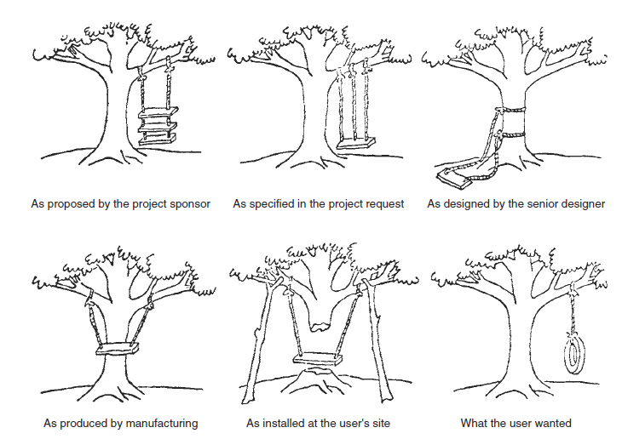
Design depends on the viewpoint of the individual who defines the problem.

Slide 28
Tools for Design Thinking

Slide 29
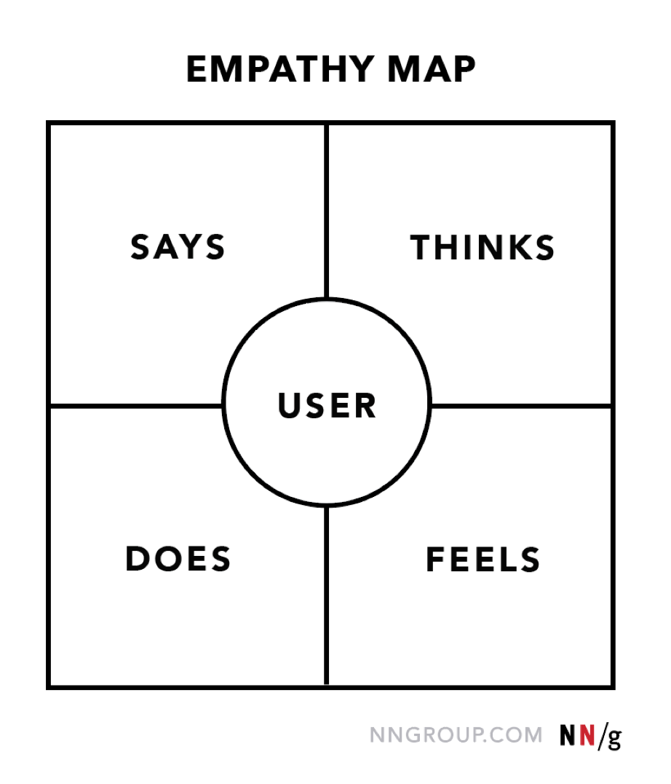
Empathy Map
An empathy map is a collaborative visualization used to articulate what we know about a particular type of user. It externalizes knowledge about users in order to
1) create a shared understanding of user needs, and
2) aid in decision making.

Slide 30
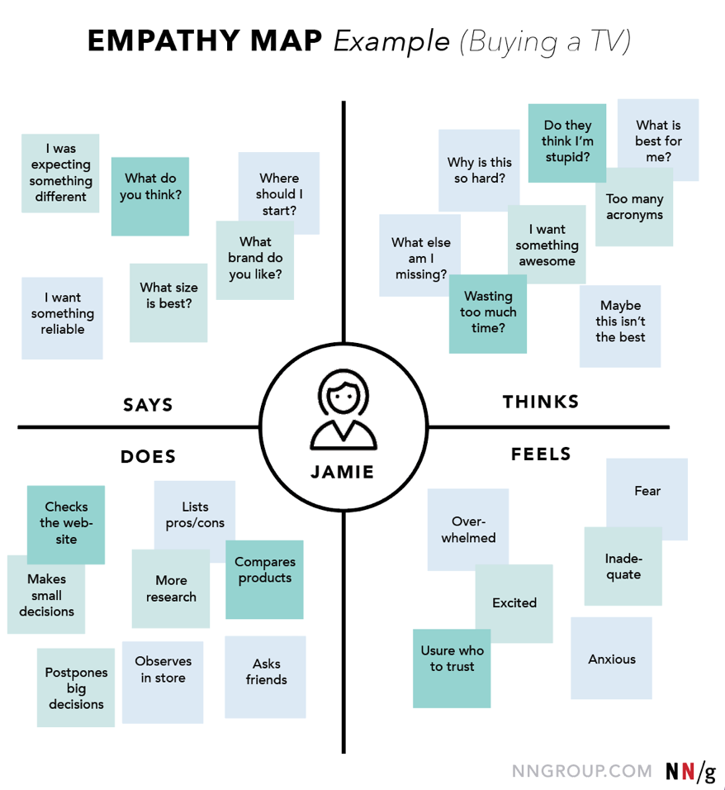
What the user says out loud
What the user is thinking throughout the experience.
What worries the user?
What does the user get excited about?
How does the user feel about the experience?
What does the user physically do?
How does the user go about doing it?

Slide 31
How to Build an Empathy Map
1. Define scope and goals
2. Gather materials
3. Collect research
4. Individually generate sticky notes for each quadrant
5. Converge to cluster and synthesize
6. Polish and plan

Slide 32
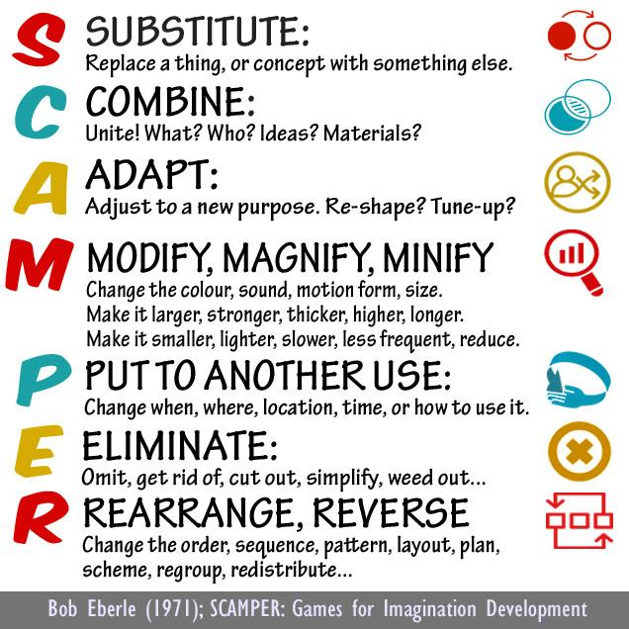
SCAMPER
The SCAMPER method helps you generate ideas for new products and services by encouraging you to ask seven different types of questions, which will help you understand how you can innovate and improve existing products, services, problems and ideas.
The SCAMPER Technique is a team brainstorming technique used to develop or improve products or services.

Slide 33
Substitute: What can be replaced? (for example, components, materials, people)
Example: if you were making windows for a children’s playhouse, you might substitute glass with plastic (for safety).
Combine: What can be combined? (for example, other features, devices)
Example: cell phones have combined phone features with cameras.
Adapt: What can be added? (such as new elements or functions)
Example: cars now have built-in wifi.
Modify, Magnify, maximize, minimize: What can be modified? (for example, change the size, shape, color, or other attribute)
Example: sunglasses reduced in size for babies or small children.
Put to other use (purpose): Could you put the product to a different use, or use it in another industry?
Example: during COVID19 pandemic, coffee filters being used as filters in masks for faces.
Eliminate or minimize: What can be removed or simplified?
Example: removing cigarette lighters from cars (to be able to use the space for charging devices?).
Reverse, reengineer, or rearrange: What would happen if you reversed the product’s production process? What can be swapped or flipped?
Example: fast food restaurants rearranged the typical eat then pay model to pay then eat.

Slide 34
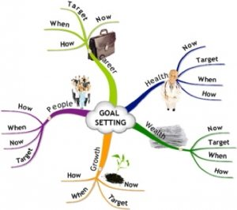
Mind Mapping
Mind mapping makes visual thinking come alive

Slide 35
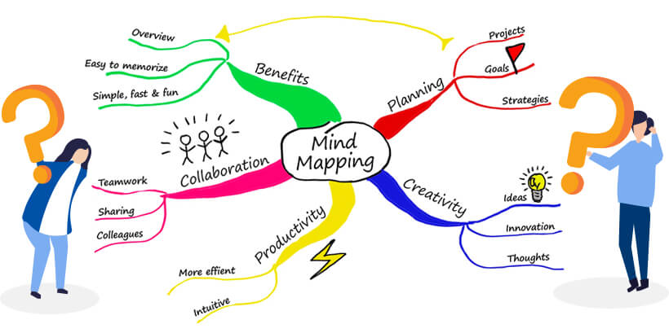
A mind map involves writing down a central theme and thinking of new and related ideas which radiate out from the centre. By focusing on key ideas written down in your own words and looking for connections between them, you can map knowledge in a way that will help you to better understand and retain information.

Slide 36
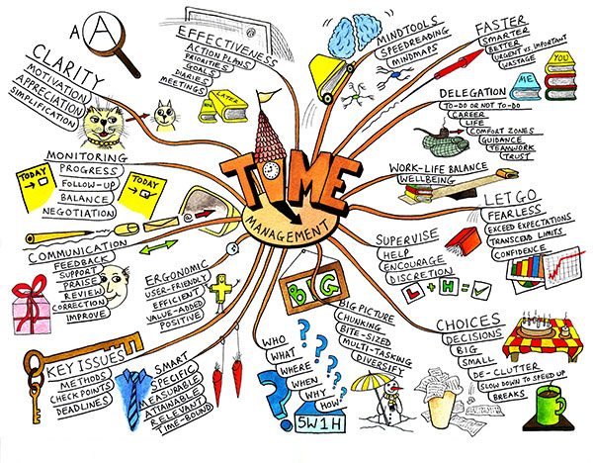

Slide 37
Innovation Flowchart
Innovation diagrams are a useful tool for the design of an innovation management processes strategy, by allowing the understanding of the needs that make an innovative idea come true.
The innovation diagram provides a roadmap for strategic action.
It helps to visualize the management process with attention to determining the human, material and economic resources that will be necessary, as well as the activities, stages and objectives that guide its implementation.
To collect key information and monitor its follow-up, technology intelligence represents a strategic tool for its development.

Slide 38
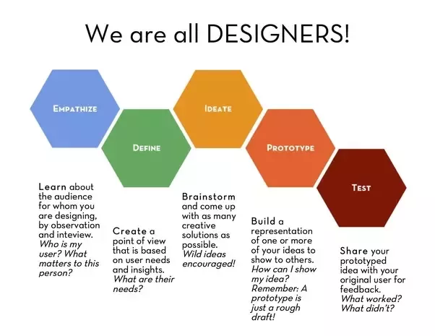

Slide 39
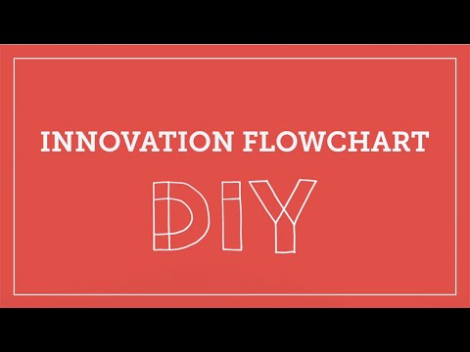

Slide 40
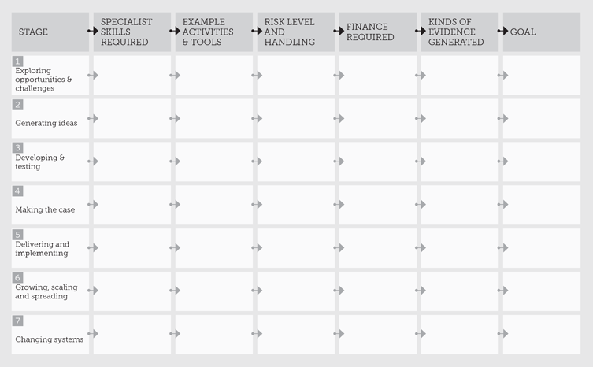
Innovation Flowchart
Open this link for more information: https://youtu.be/572wbk1rUAA

Slide 41
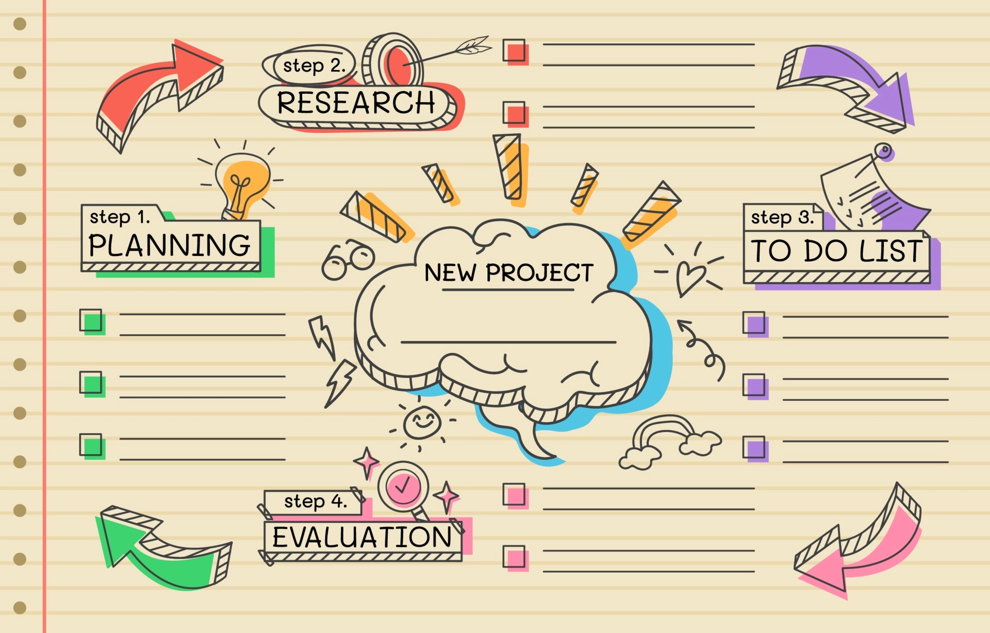

Slide 42
Thanks!

